Slide 1

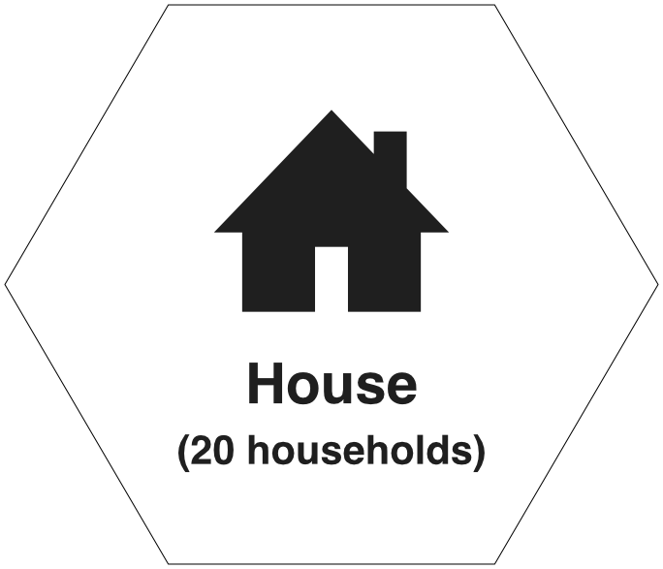


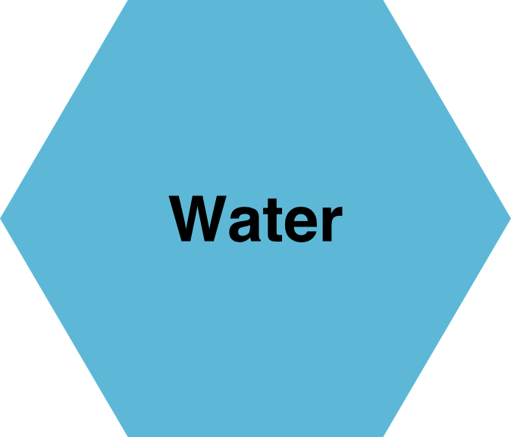
The Planning Game
Notes:
Welcome to the game
This is about planning

Slide 2
A game about planning
A game about planning
communities & their needs
planning complexity and trade-offs
regional priorities
Notes:
Where you get to think about communities and their needs, planning complexity and tradeoffs, and working with others on regional priorities.
This game should get you talking to each other, learning more about planning and have a bit of fun along the way
It’s a bit like planning, but hugely simplified for this game.

Slide 3
Winners for each category
The best Local Plan
The best storyline
Most impressive negotiation skills
Most desirable town
The best presentation performance
Notes:
At the end of the game, you will be voting in these categories.

Slide 4
The format
ten teams
four 20-minute rounds
presentations
Group voting

Slide 5
Getting ready
Organise into ten teams
Mixed experience
Planners, divide!
Notes:
Don’t just sit with your team.
If you are of have been a planner, don’t be on the same team as another planner

Slide 6
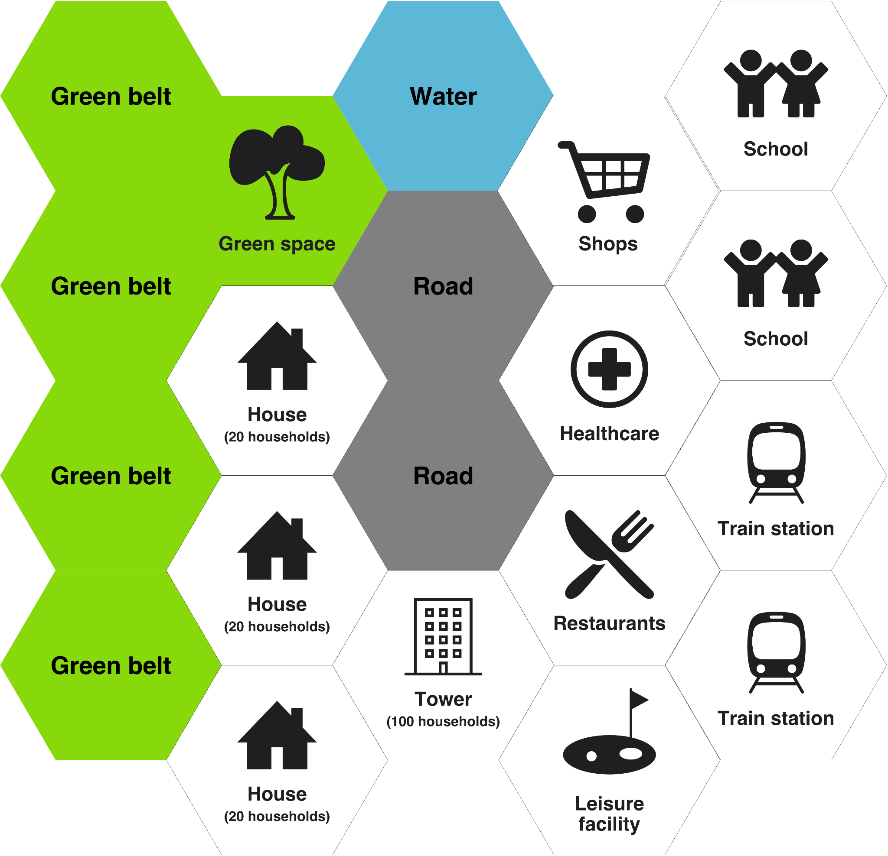
Round 1
Make your town
(20mins)
Notes:
Use the facilitators notes

Slide 7
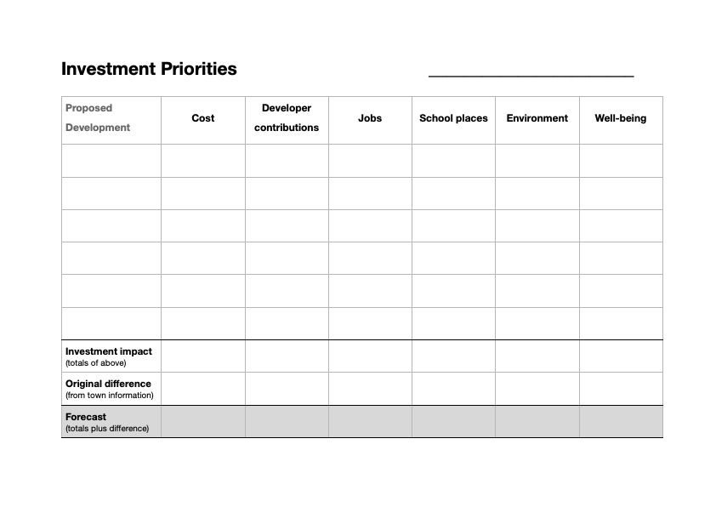
Round 2
Growing Your Town
(20mins)
Notes:
Use the facilitators notes

Slide 8
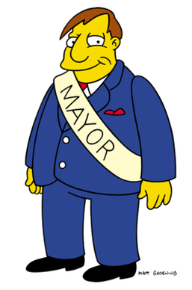
Round 3
New Mayor, new priorities
(20mins)
Notes:
Use the facilitators notes

Slide 9
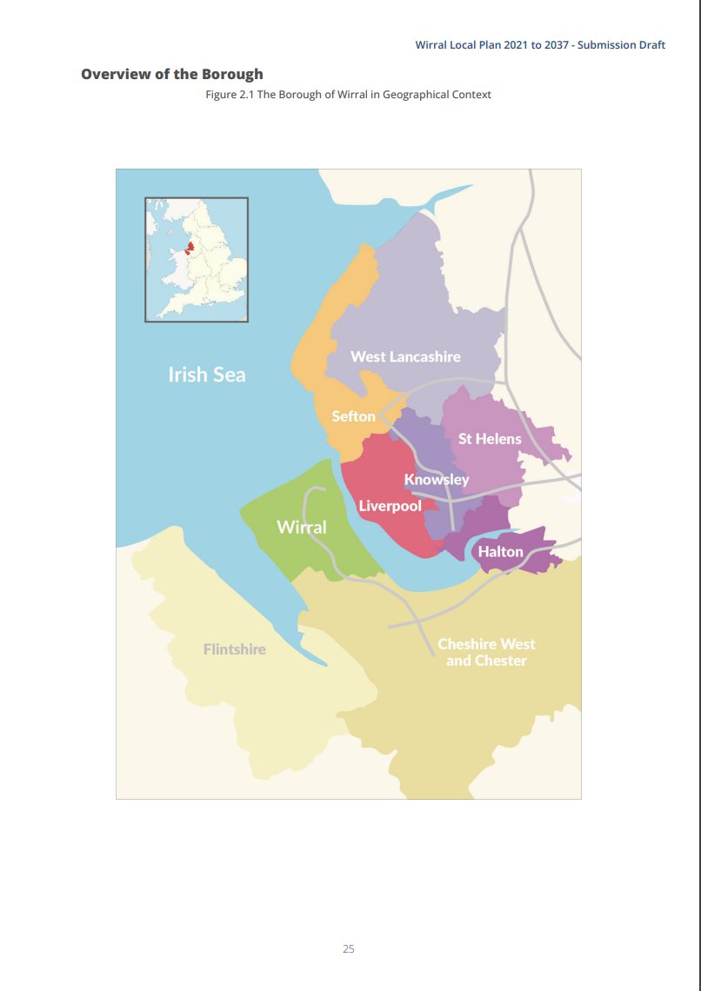
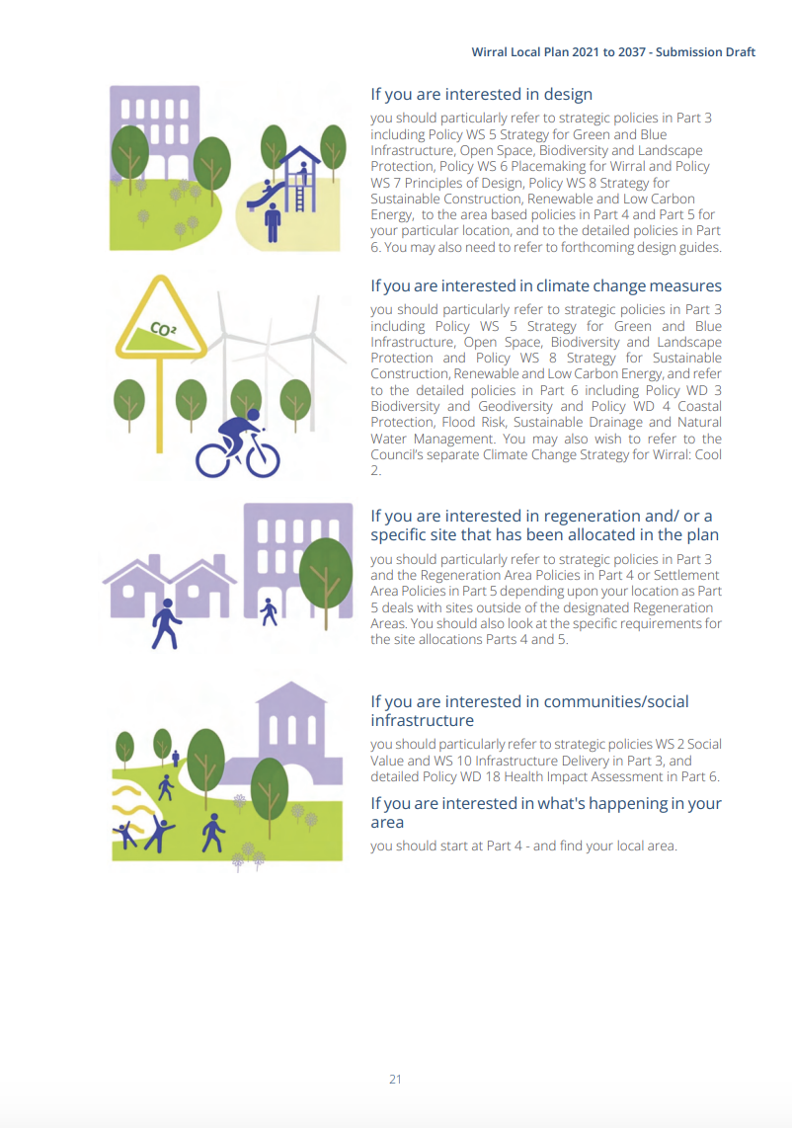
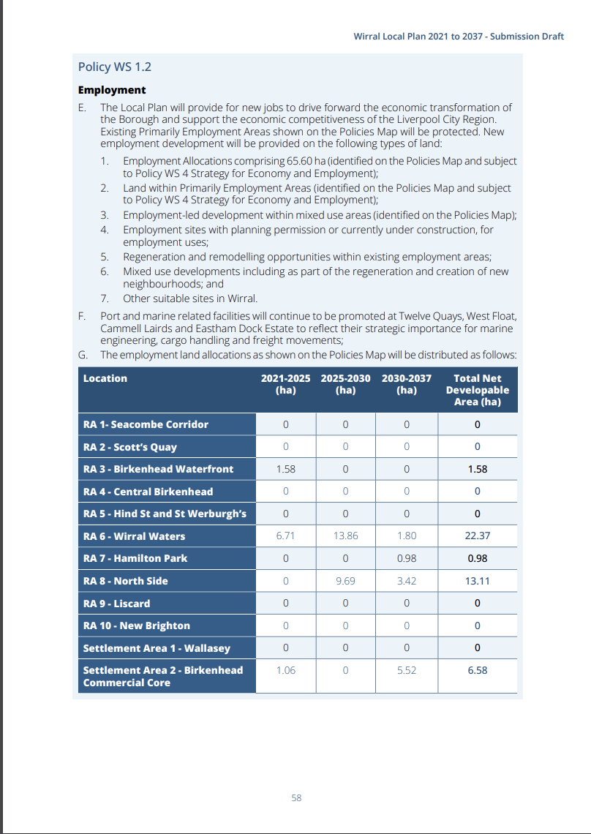

Round 4
Create Your
Local Plan
(20mins)
Notes:
Use the facilitators notes

Slide 10
Presenting
Sharing your plans with the room
(5 mins each)

Slide 11
Voting
Top 3 in each category
Notes:
Add a voting mechanism

